Slide 1
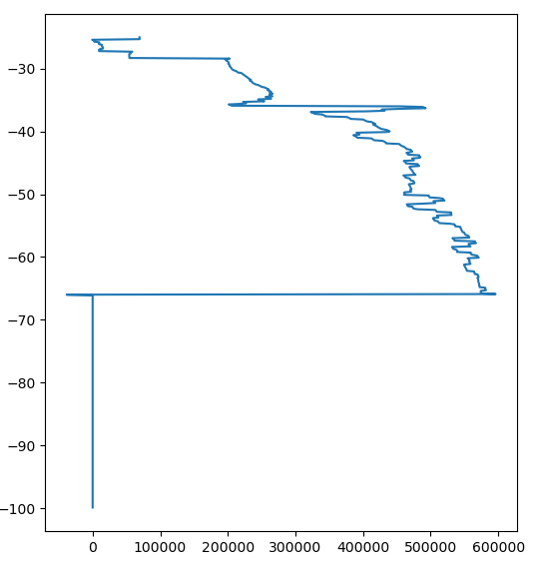

Across the exhaustive dataset 9623 traces have values below -10k
My suggestion:
Set all these values to 0, because they are most often at the seafloor boundary.
I plotted this with axes flipped. Don’t know why this one did not get flipped.. Worked for the other plots I sent you

Slide 2
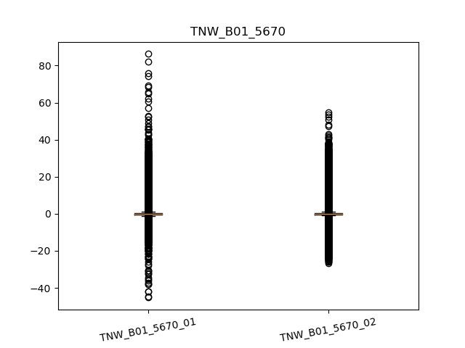
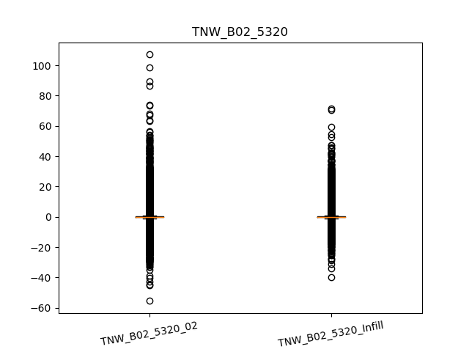
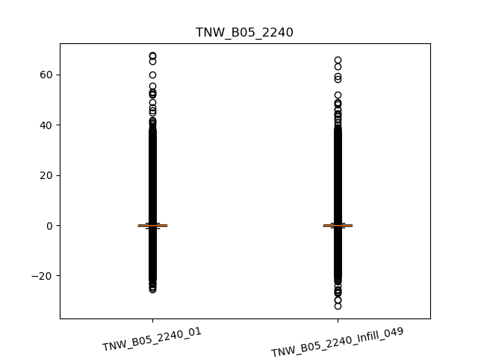
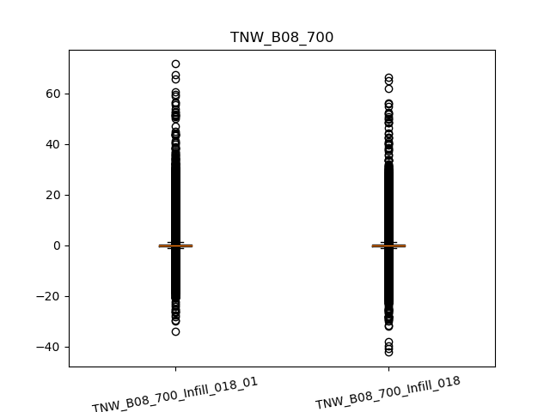
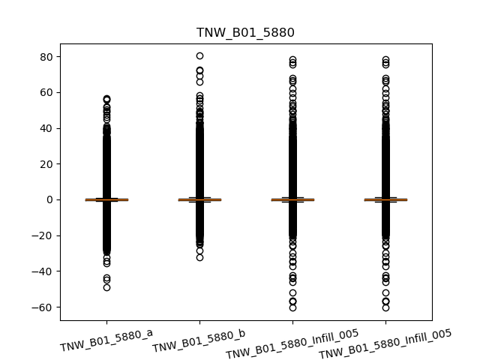
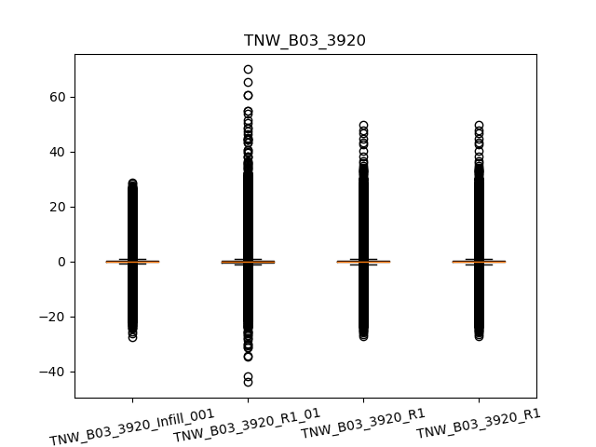
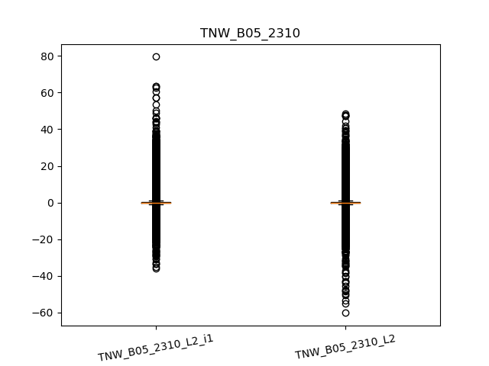
Dupelicates in the dataset: Many outliers
Not sure why this happened; dataset does not contain two of these

Slide 3
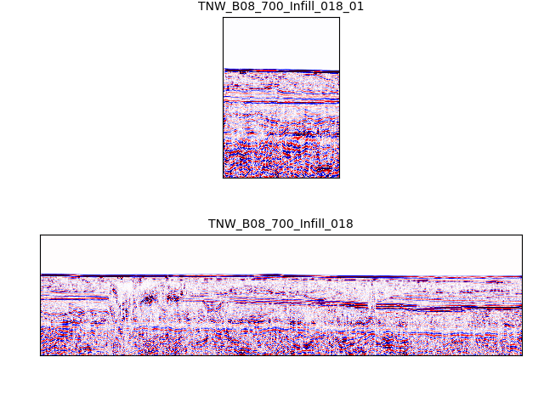
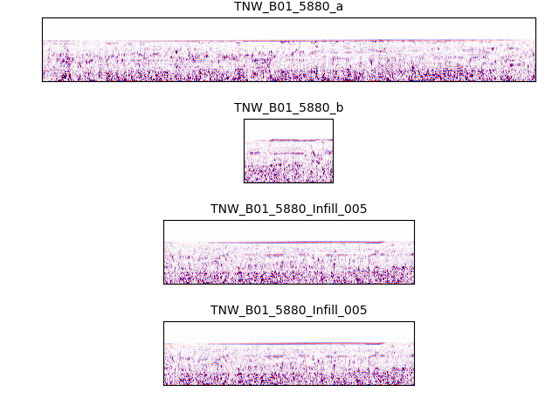
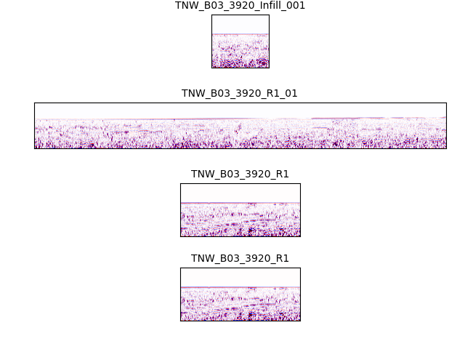
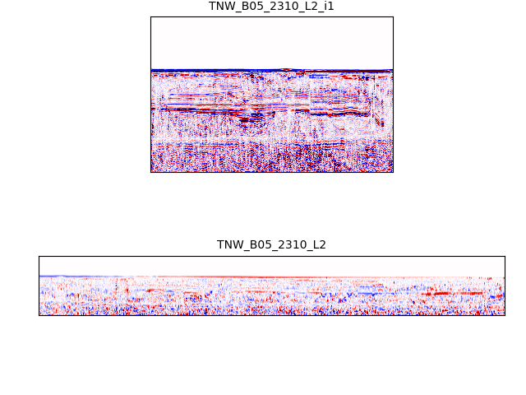
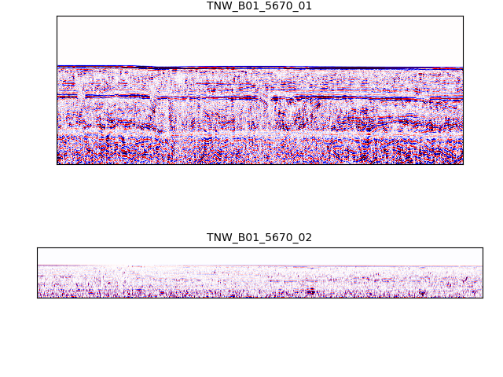
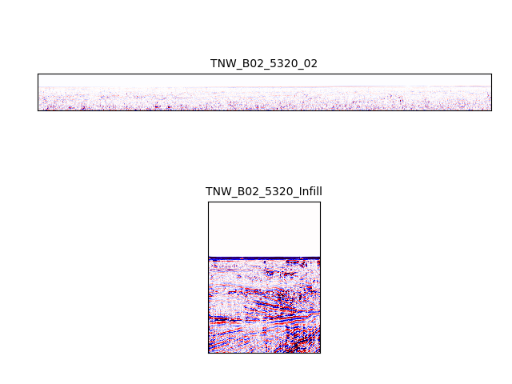
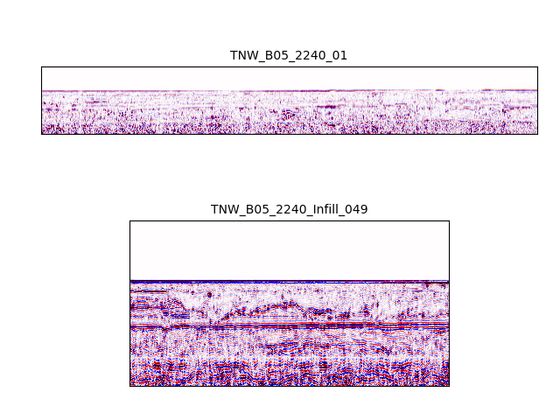
Dupelicates in the dataset: different intensity of signal
All these images are normalized using vmin = -2, vmax = 2

Slide 4
Dataset considerations
MinMax Scaling gets affected by outliers
Outliers: removed / set to a certain value
Model performance may get affected by outliers

Slide 5
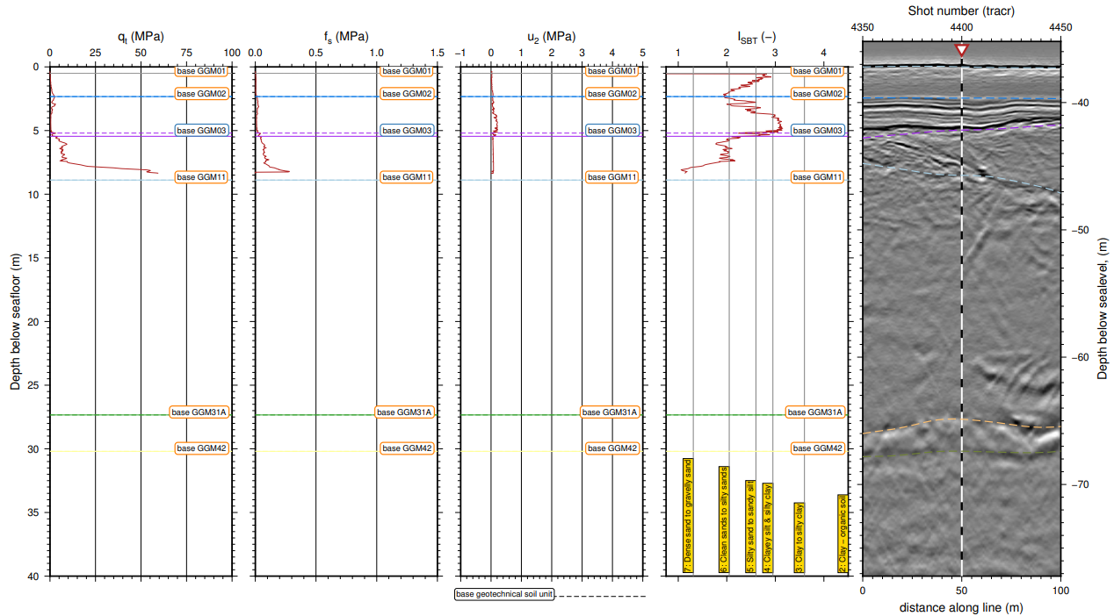
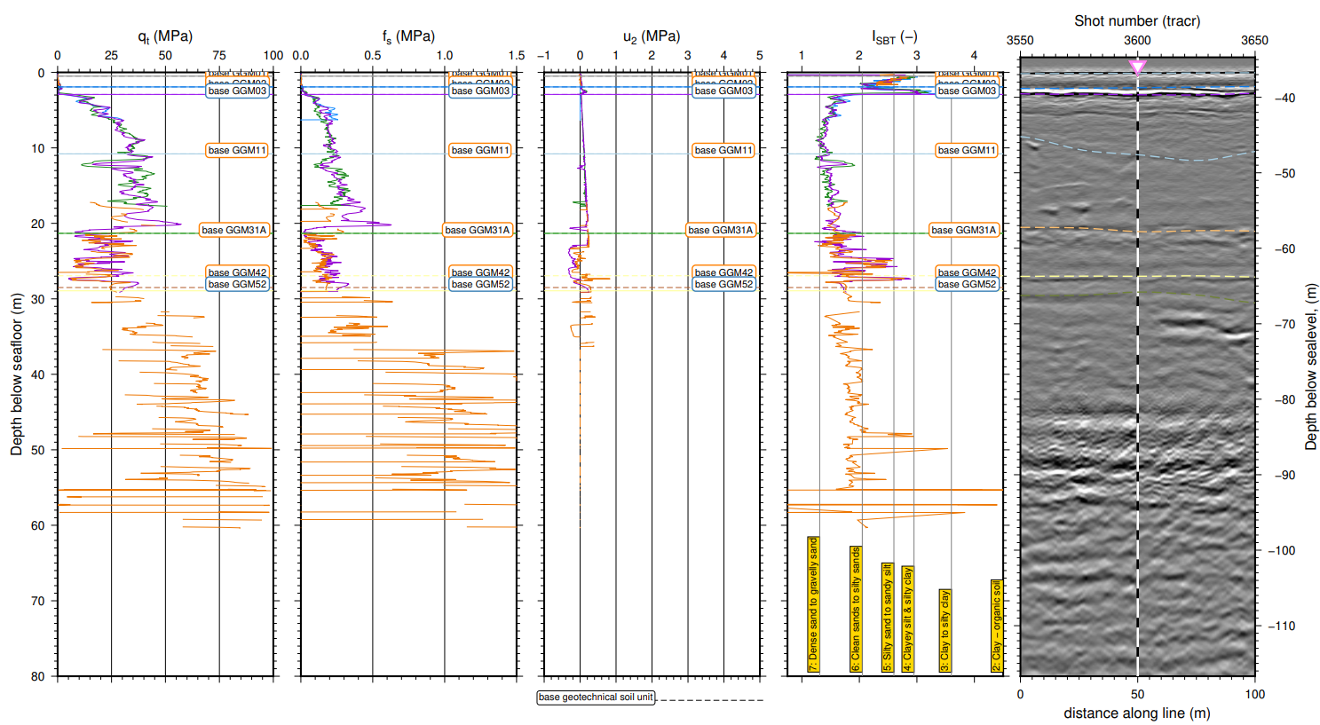
Discontinuous CPT Data
Different depths of data; Not all data present at all depths

